Slide 1
Backpropagation in CNNs
University of Information Technology (UIT)
Quan Hoang Ngoc, Dai Truong Le Trong, Hoang Long Nguyen Huu

Slide 2
01
Problem – Solving
02
CNN Architecture
Backpropagation Overview
03
Table of
Contents
Backpropagation in each layer class
04
Purpose of Layers and Visualization
05
The experiment
06
07
Task using CNN and applications

Slide 3
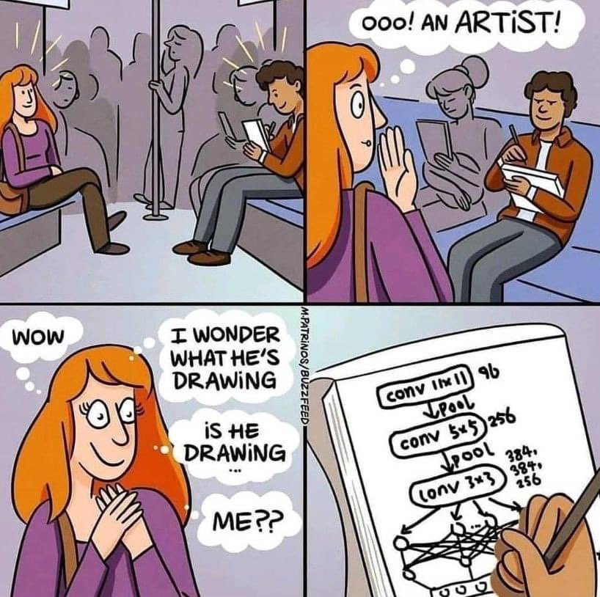
Table of Contents

Slide 4
References
Content
Geekforgeek: https://www.geeksforgeeks.org/introduction-convolution-neural-network/
Only Numpy: Understanding Back Propagation for Max Pooling Layer in Multi Layer CNN with Example and Interactive Code. (With and Without Activation Layer) | by Jae Duk Seo | The Bioinformatics Press | Medium
How does Backpropagation work in a CNN? | Medium
www.pycodemates.com/2023/07/backward-pass-in-convolutional-neural-network-explained
Backpropagation In Convolutional Neural Networks | DeepGrid (jefkine.com)
Visualization:
https://poloclub.github.io/cnn-explainer/

Slide 5
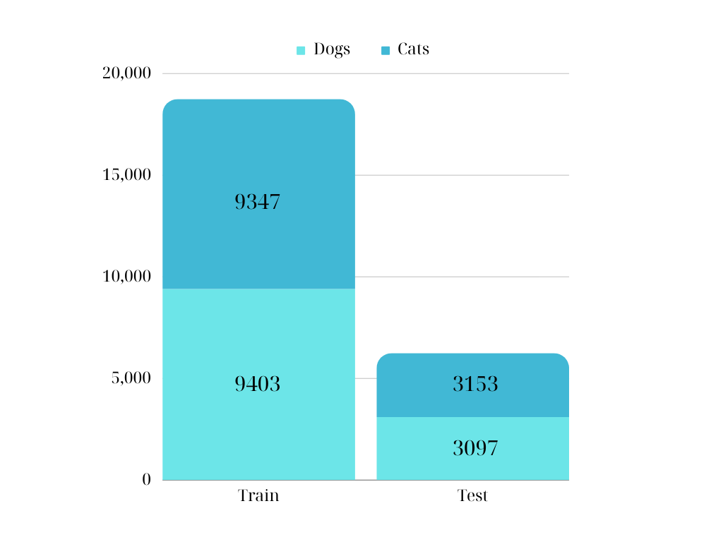
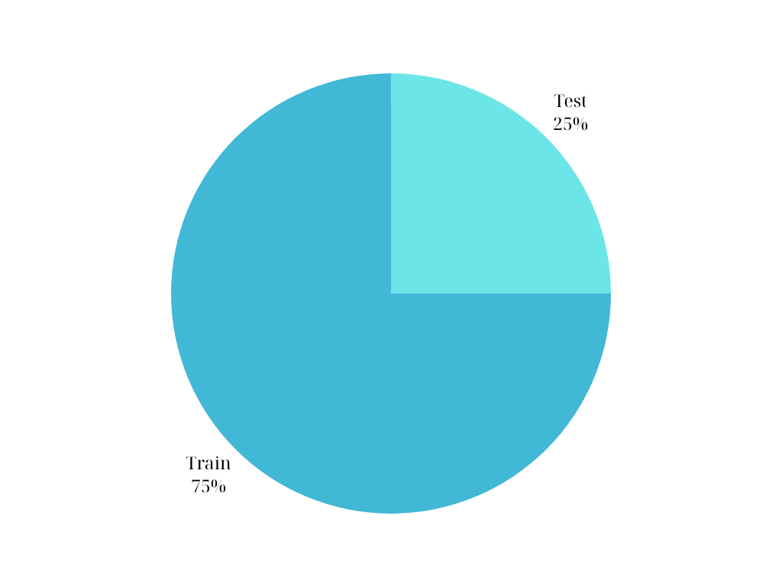
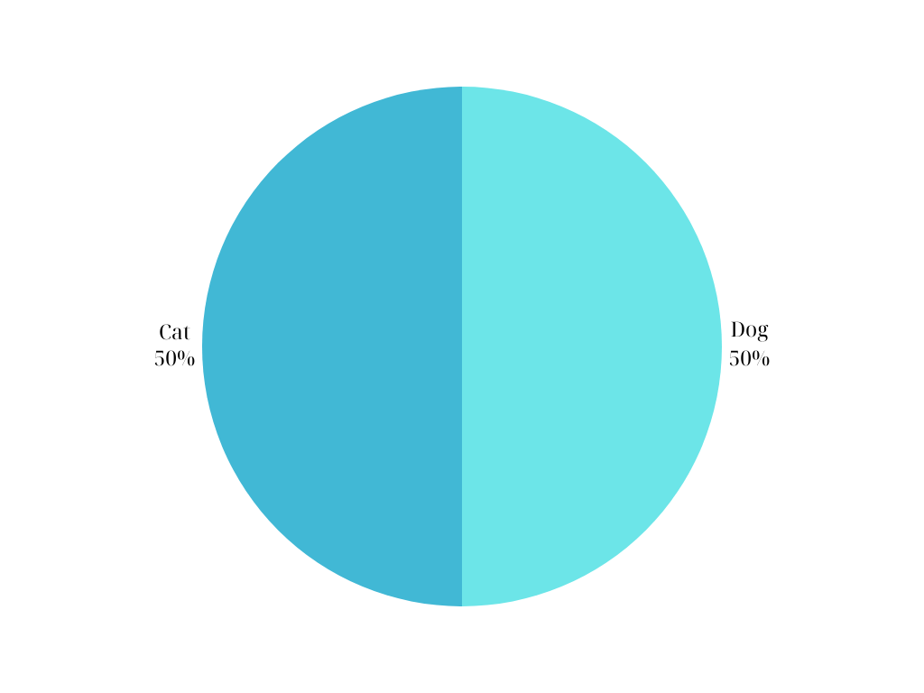
Problem
Abstraction
Dog Cat Image Classification
https://www.kaggle.com/c/dogs-vs-cats/data?fbclid=IwAR217O7VxOFWE6Eb5bqiQCe1CrOQ9-Q4sgX_8RcxRUmpHmfyzzdsxhTI7wY

Slide 6
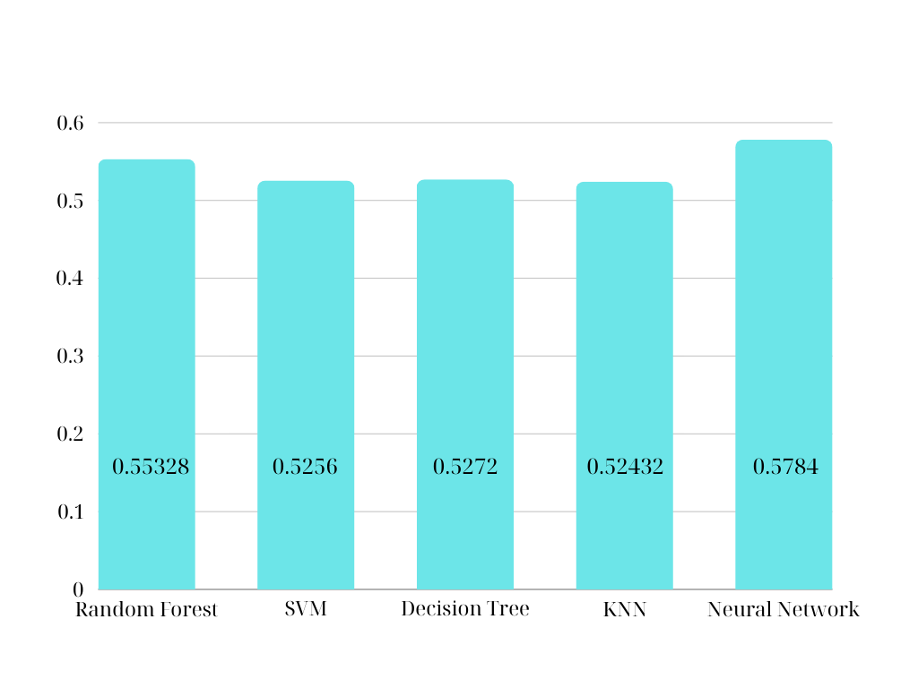
Problem
Dashboard
Accuracy on test set of models

Slide 7
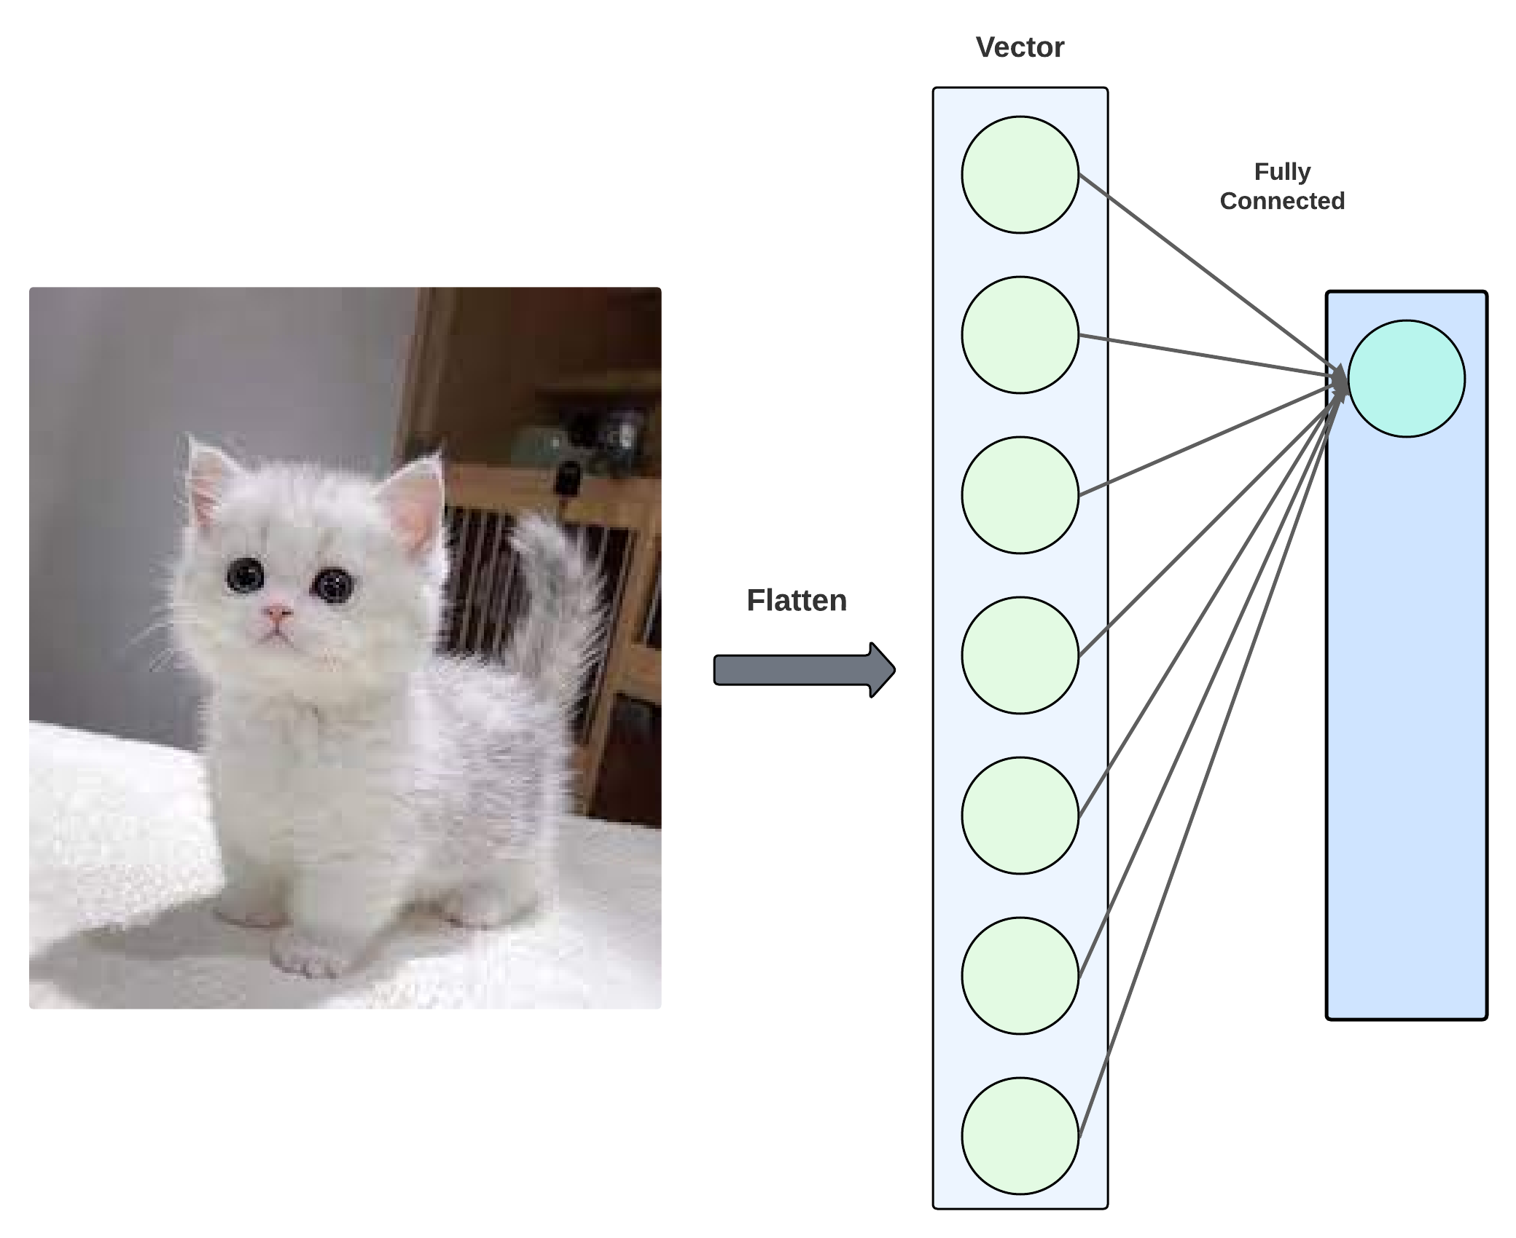
Problem
The limitation of these models

Slide 8
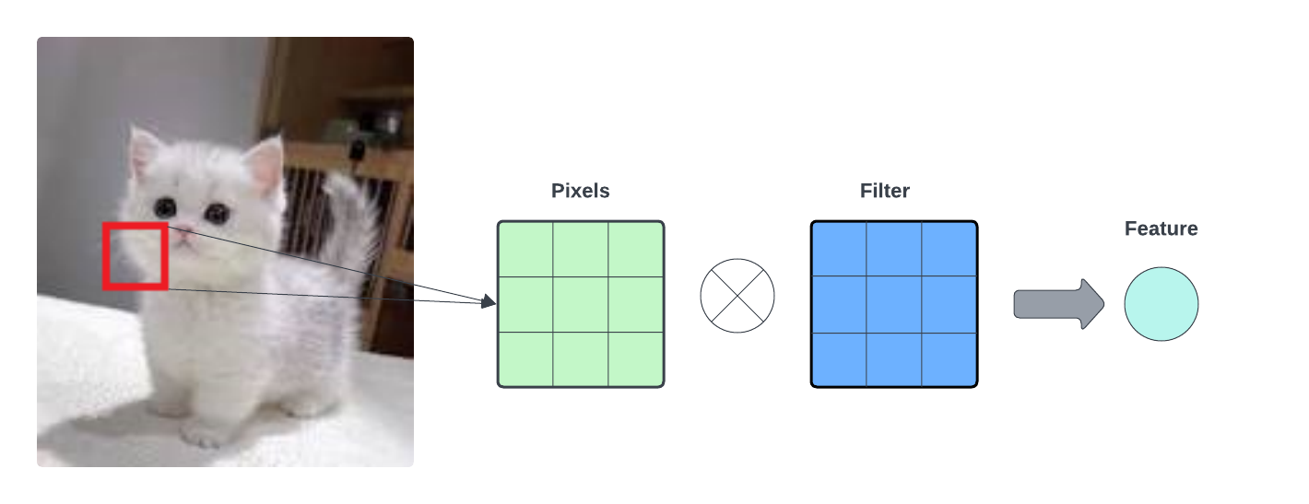
Solving
The approach

Slide 9
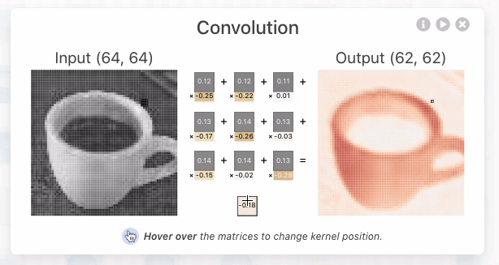
Solving
Convolution operator

Slide 10
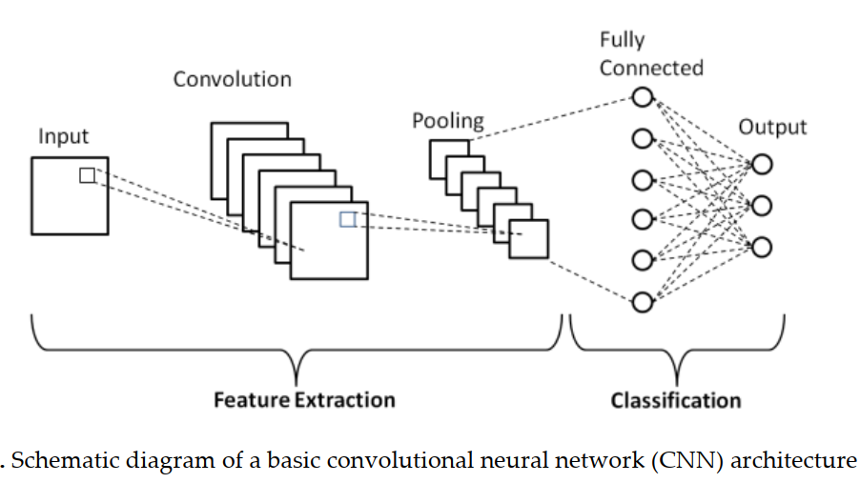
Solving
CNN architecture

Slide 11
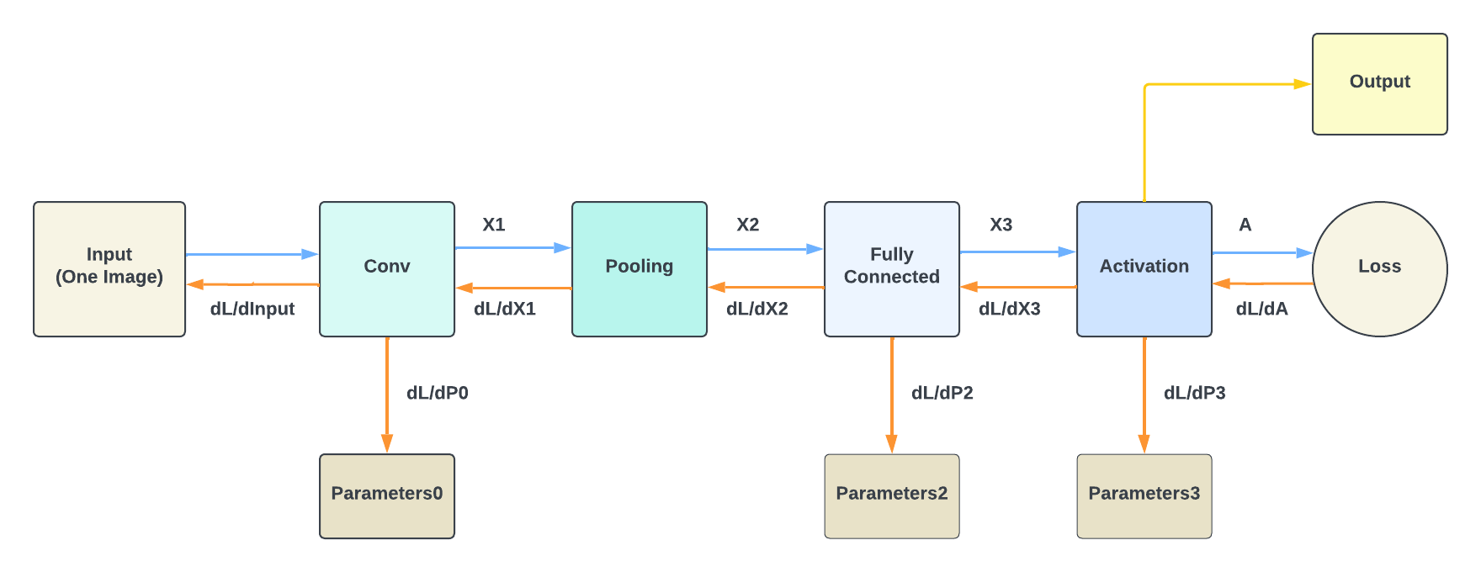
Backpropagation Overview
Computation Graph

Slide 12
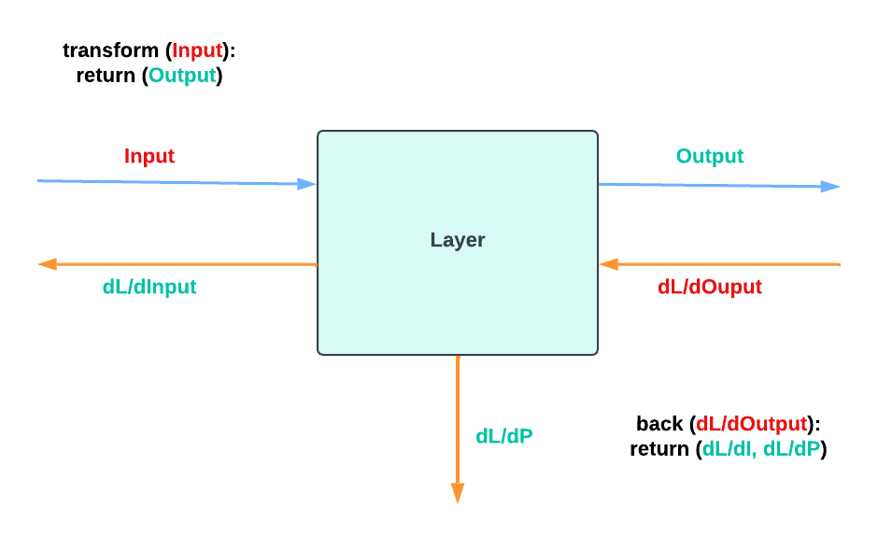
Backpropagation Overview
Computation Graph in each layer

Slide 13
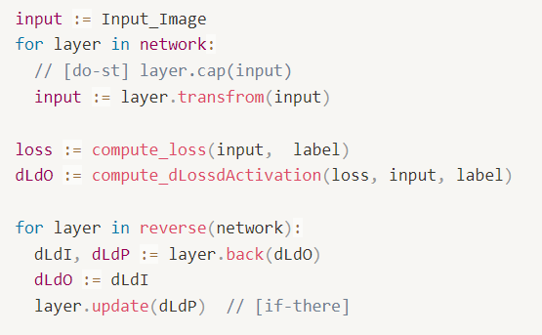
Backpropagation Overview
Backpropagation Algorithm

Slide 14
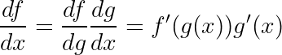
1. Chain rule

Slide 15
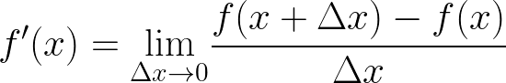
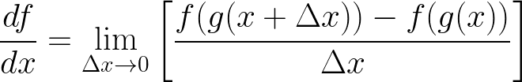
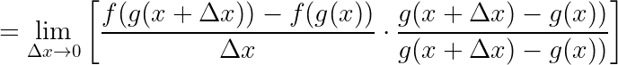
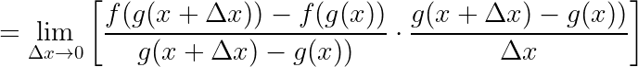
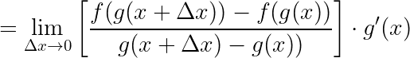
1. Chain Rule
Notes:
\frac{df}{dx} = \underset{\Delta x\rightarrow 0 }{\lim} \left [ \frac{f(g(x+\Delta x))-f(g(x))}{\Delta x} \right ]
=\underset{\Delta x\rightarrow 0 }{\lim} \left [ \frac{f(g(x+\Delta x))-f(g(x))}{\Delta x} \cdot \frac{g(x+ \Delta x) - g(x))}{g(x+ \Delta x) - g(x))} \right ]
=\underset{\Delta x\rightarrow 0 }{\lim} \left [ \frac{f(g(x+\Delta x))-f(g(x))}{g(x+ \Delta x) - g(x))}\right ] \cdot g'(x)
=\underset{\Delta x\rightarrow 0 }{\lim} \left [ \frac{f(g(x+\Delta x))-f(g(x))}{g(x+ \Delta x) - g(x))} \cdot \frac{g(x+ \Delta x) - g(x))}{\Delta x} \right ]
=\underset{\Delta x\rightarrow 0 }{\lim} \left [ \frac{f(g(x+\Delta x))-f(g(x))}{g(x+ \Delta x) - g(x))}\right ] \cdot \underset{\Delta x\rightarrow 0 }{\lim} \left [ \frac{g(x+ \Delta x) - g(x))}{\Delta x} \right ]

Slide 16
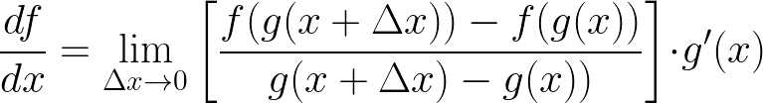
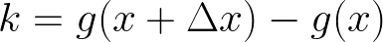
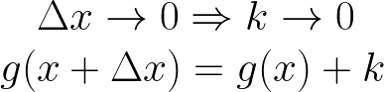
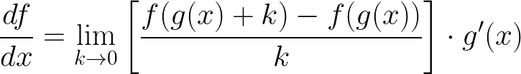
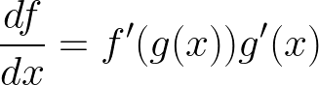
1. Chain rule
Let
Notes:
\frac{df}{dx} = \underset{\Delta x\rightarrow 0 }{\lim} \left [ \frac{f(g(x+\Delta x))-f(g(x))}{g(x+ \Delta x) - g(x))}\right ] \cdot g'(x)
\frac{df}{dx} = \underset{k \rightarrow 0 }{\lim} \left [ \frac{f(g(x) + k)-f(g(x))}{k}\right ] \cdot g'(x)

Slide 17
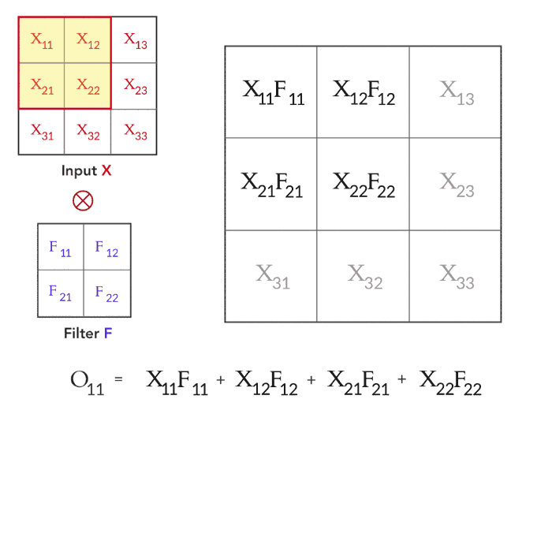
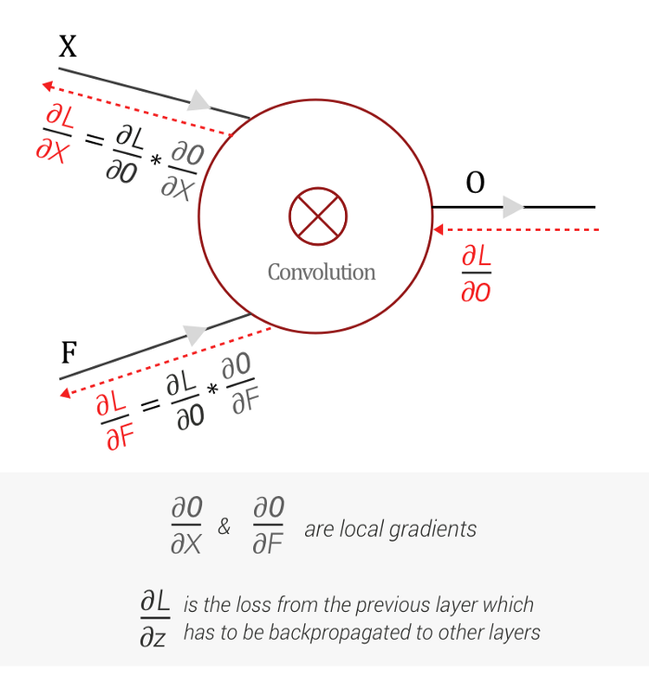
2. Convolution backpropagation
Notes:
How does Backpropagation work in a CNN? | Medium
Backpropagation In Convolutional Neural Networks | DeepGrid (jefkine.com)

Slide 18
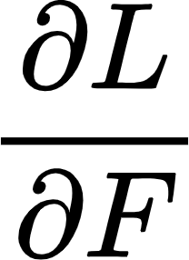
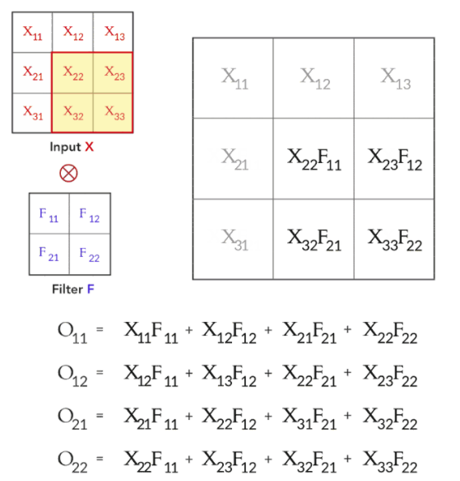
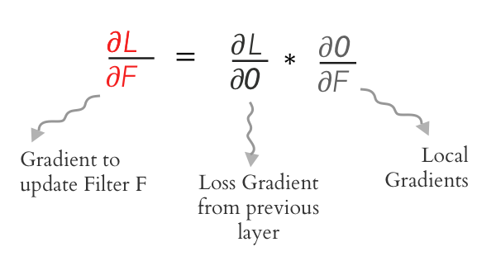
2. Convolution backpropagation - Find

Slide 19
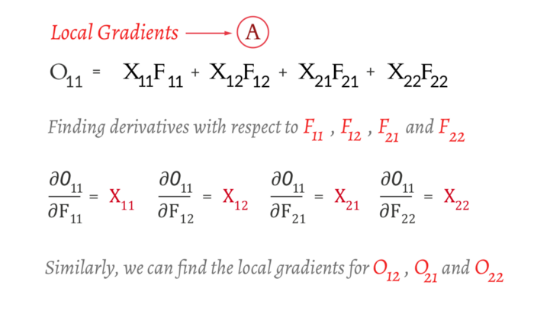
2. Convolution backpropagation - Find

Slide 20
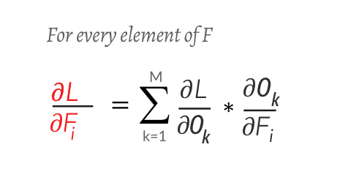
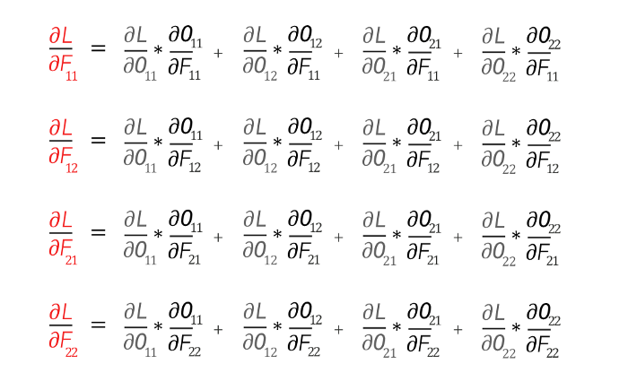
2. Convolution backpropagation - Find

Slide 21
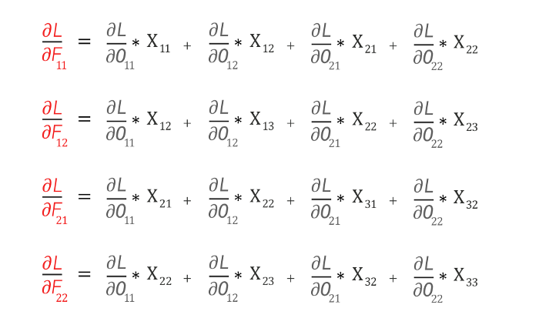
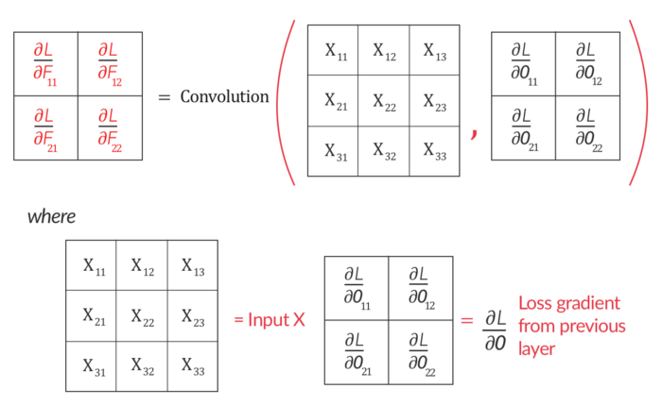
2. Convolution backpropagation - Find

Slide 22
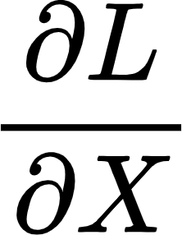
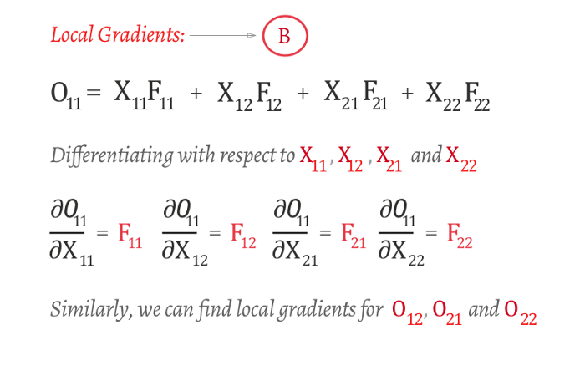
2. Convolution backpropagation - Find

Slide 23
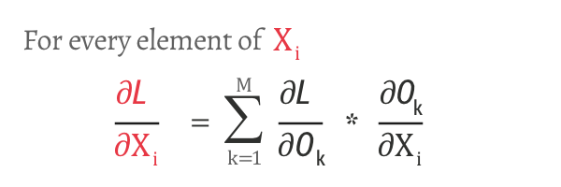
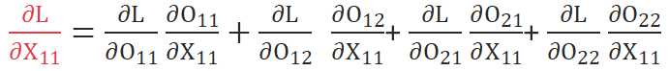
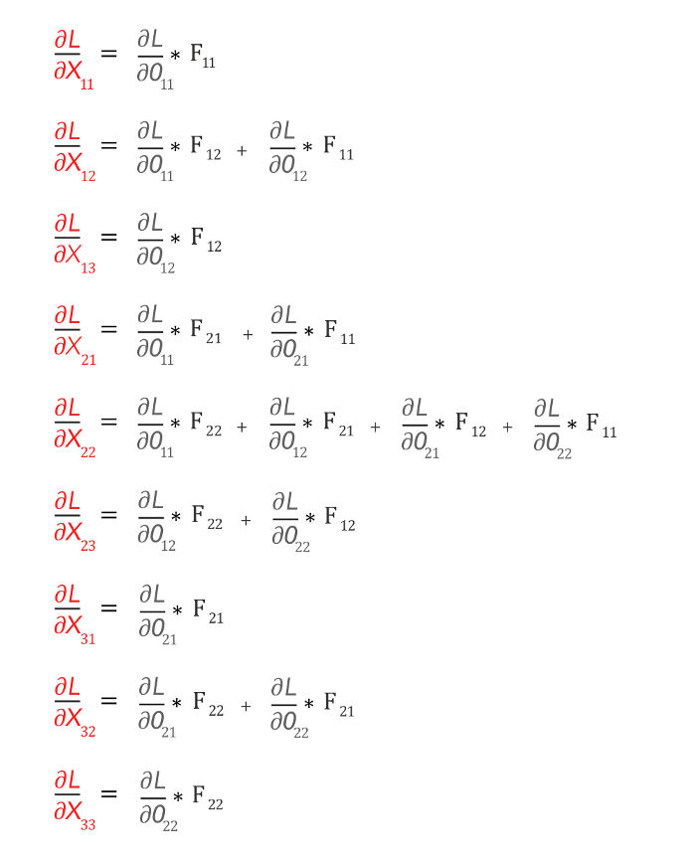
2. Convolution backpropagation - Find

Slide 24
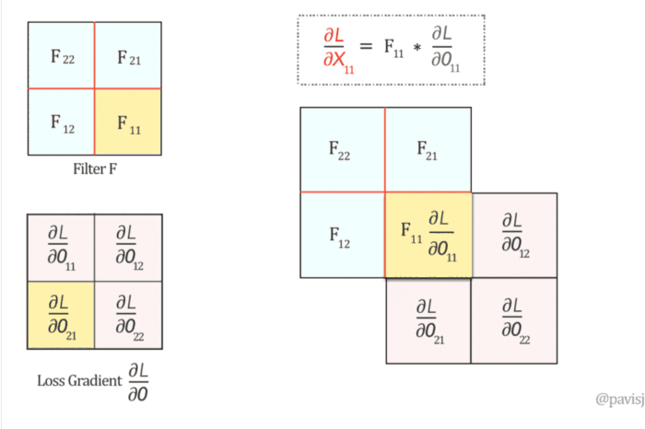
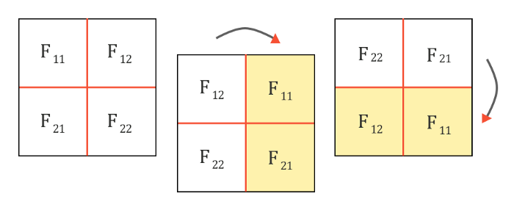
2. Convolution backpropagation - Find

Slide 25
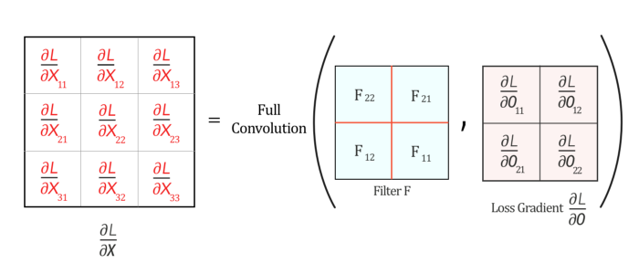
2. Convolution backpropagation - Find

Slide 26
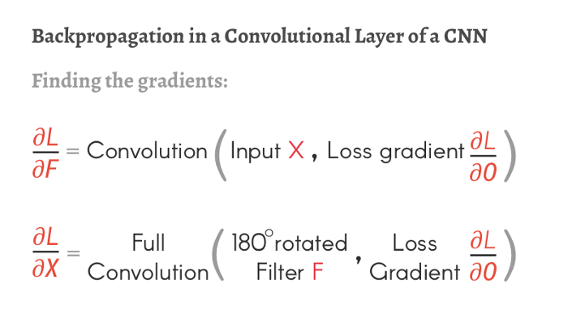
2. Convolution backpropagation - Summary

Slide 27
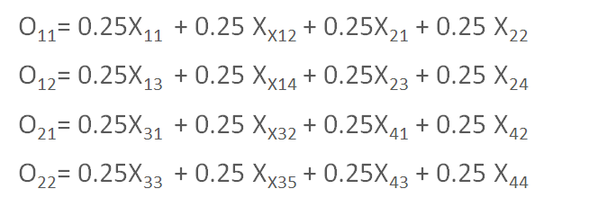
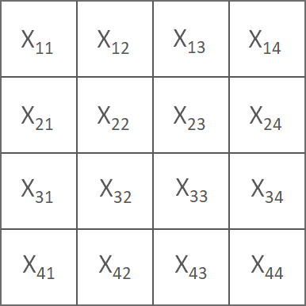
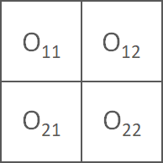
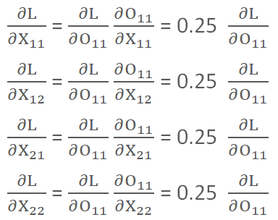
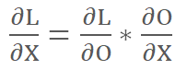
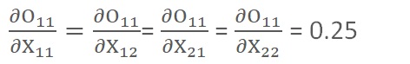
3. Pooling backpropagation - Average pooling
Average pooling
Notes:
Only Numpy: Understanding Back Propagation for Max Pooling Layer in Multi Layer CNN with Example and Interactive Code. (With and Without Activation Layer) | by Jae Duk Seo | The Bioinformatics Press | Medium

Slide 28
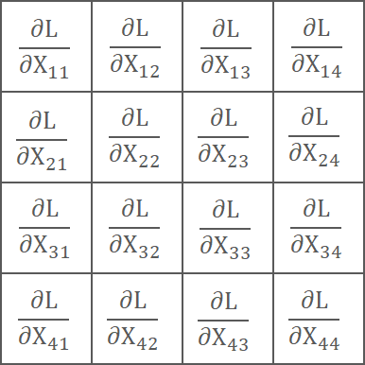
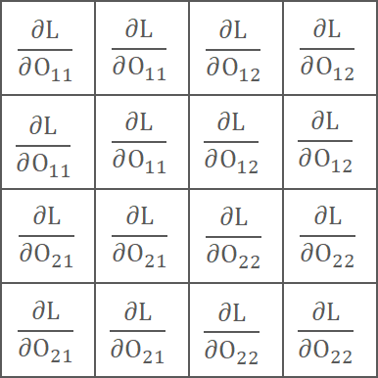



3. Pooling backpropagation - Average pooling
=
*

Slide 29

3. Pooling backpropagation - Max pooling
Max pooling

Slide 30




3. Pooling backpropagation - Max pooling
=

Slide 31


3. Pooling backpropagation - Max pooling
=
*

Slide 32
Purpose of Convolution layers
Using multiple convolution layers in a CNN allows the network to learn increasingly complex features from the input image or video.
The first convolution layers learn simple features, such as edges and corners.
The deeper convolution layers learn more complex features, such as shapes and textures.
Purpose of Pooling layers
Pooling layers reduce feature map dimensions while retaining crucial information using operations like max pooling (selecting maximum values) or average pooling (calculating averages).

Slide 33






Visualization
MNIST digit 0 and 1
Image
Conv
ReLU
Conv
ReLU
Pooling
https://poloclub.github.io/cnn-explainer/

Slide 34

The experiment: Comparison of models
The result of Cat Dog Image Classification experiment

Slide 35

The experiment: Comparison of models
VGG 16

Slide 36

The experiment: Comparison of models
VGG 16

Slide 37
Advantages and Disadvantages of CNNs
Advantages:
Use raw pixel data
No require manual feature engineering (feature extractor) or pre-processing (PCA)
➔ Automatic feature extractor
➔ Adapt to the most salient characteristics of the images, such as edges, shapes, colors, textures, and objects → generalize well to new data and recognize pattern of image.
Reduce Dimensionally → training and inference faster and more efficient.
Transfer Learning, data argumentation.
Disadvantages:
Hard to interpret and explain: human interpretable.
Require a large amount of labeled data to train effectively.
Hardware: computation cost (GPU).
Overfitting.
Curse of Dimensionality.
https://www.linkedin.com/advice/0/what-advantages-disadvantages-using-convolutional

Slide 38

Tasks using CNN and applications
Image Classification
Object Recognition
Object Detection
Image Segmentation

Slide 39
LQD.QT Product
Shoes Match
Shoes Virtual Try-on
Dat Tran, Long Nguyen Huu Hoang, Quan Hoang Ngoc, Thu Tran Van Anh, Truong Le Trong Dai
LQD.QT
References: Paper ARShoe
Paper ARShoe: Real-Time Augmented Reality Shoe Try-on System on Smartphones (https://arxiv.org/pdf/2108.10515.pdf)

Slide 40
Thank you
THANKS

Slide 41




1. Chain Rule

Slide 42
Formular in Traditional Layers (Nerual Network)

Slide 43
Sourcecode Demo for Layers (ViCNN.ipynb)

Slide 44
Problem of Gradient Exploding and Vanishing
Activation,
Initialization Method, Training Update Method (Adam)
Visualization

Slide 45
Purpose of Convolution layers
Using multiple convolution layers in a CNN allows the network to learn increasingly complex features from the input image or video.
The first convolution layers learn simple features, such as edges and corners.
The deeper convolution layers learn more complex features, such as shapes and textures.
Purpose of Pooling layer
Convolution layers use learnable filters to detect specific patterns in input data, such as edges or textures, forming feature maps.
Pooling layers reduce feature map dimensions while retaining crucial information using operations like max pooling (selecting maximum values) or average pooling (calculating averages).

Slide 46
Top CNN Models
VGG
AlexNet
ResNet
GoogLeNet
MobileNet
R-CNN and Fast R-CNN, Faster R-CNN
https://datagen.tech/guides/computer-vision/cnn-convolutional-neural-network/

Slide 47
Visualization
https://poloclub.github.io/cnn-explainer/

